Slide 1
B2B Jewellry Catalog Mobile Application(PS10)
Joyel Albert m
iii/cse
KnowlEdge InstituTe of technology
KANIMOZHI M
III/CSE
KNOWLEDGE INSTITUTE OF TECHNOLOGY

Slide 2
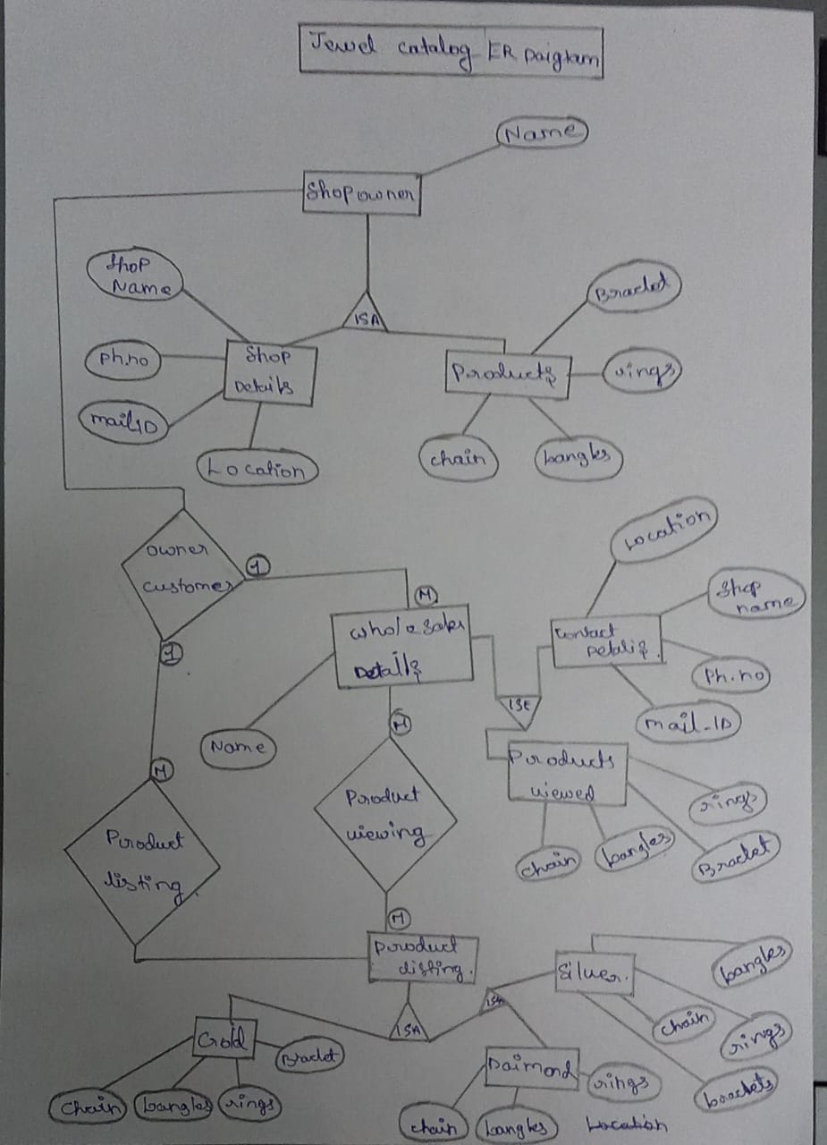
ER DIAGRAM :

Slide 3
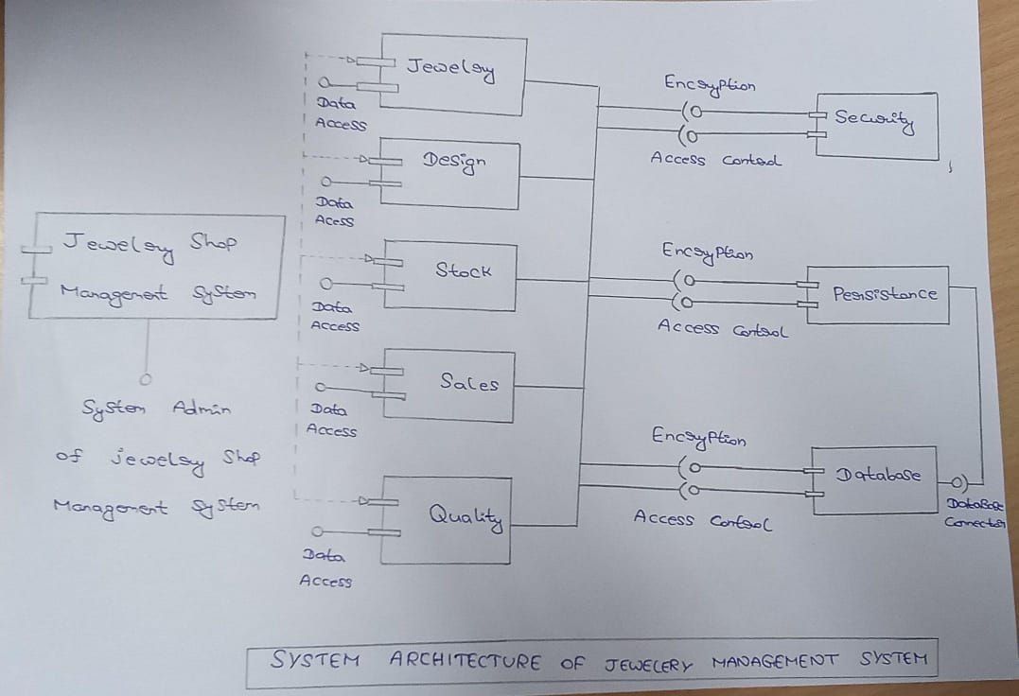
SYSTEM ARCHITECTURE DIAGRAM:

Slide 4
MODULE:
As part of first module development we have created the Home page and Login page.
These two screens form the foundation of the user experience and allowing user to access app and view collection.
HOME PAGE : Designed to showcase featured jewelry items and guide users to different sections of the app.
LOGIN PAGE : Secure user Authentication page that enables registered users to log in and access personalized features.

Slide 5
MODULE
Displays all available jewelry products in a structured and user friendly layout.
It Includes product image, name, price and category.
Jewelry Catalog is the Heart of our app, handling the jewelry catalog listing, adding, viewing, and managing jewelry pieces.
Integrated Flutter Hive for Local data storage.
Products are fetched and stored efficiently in the Hive database.
It Ensures fast Loading and offline access capability.

